Slide 1


55th IG Meeting
South Gas Regional Initiative
15th September 2020
Telco

Slide 2
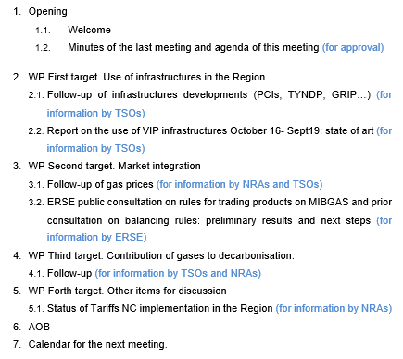
DRAFT AGENDA

Slide 3
2. WP First target: use of infrastructures in the Region
2.1. Follow-up of infrastructure development (PCIs, TYNDP, GRIP…)
  For information by TSOs

Slide 4
2. WP First target: use of infrastructures in the Region
  2.2. Report on use of infrastructures (Oct16-Sept19): state of play and next steps (for information by TSOs)
    Detailed index approved
    Period of analysis was extended: Oct16-Sept19
    TSOs submitted a first draft to CNMC
    Draft report was submitted to NRAs for comments
    Presentation of draft report after NRA´s comments (sent to NRA´s on August 31st)
    The way forward (approval)
  For information by TSOs

Slide 5
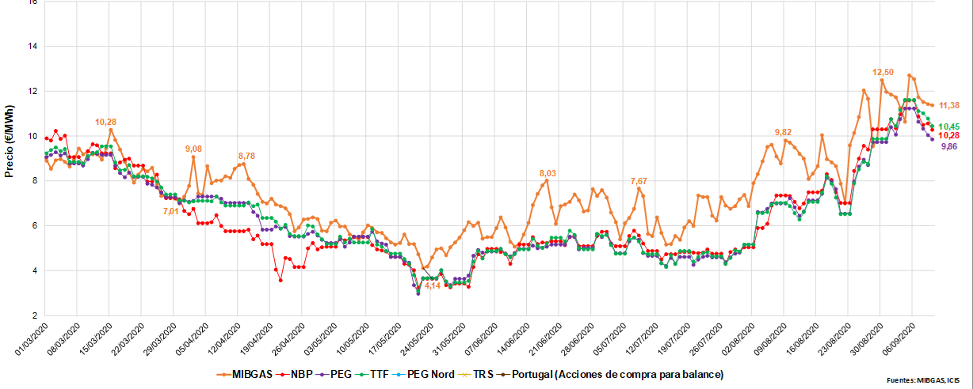
3. WP Second target: market integration
3.1. Follow-up of gas prices SGRI hubs vs. neighbouring hubs
(for information by NRAs and TSOs)
Evolution of prices D+1 (1st March 2020- 10th September 2020)

Slide 6
3. WP Second target: market integration
3.2. ERSE public consultation on rules for trading products on MIBGAS and prior consultation on balancing rules: preliminary results and next steps
  MIBGAS, S.A. elaborated a proposal for trading rules in MIBGAS of products to be delivered in the Portuguese VTP;
  The negotiation of products in Portugal requires the approval of some associated procedures, namely, for the daily authorization by the TSO for market participants to operate in MIBGAS;
  A revision of balancing rules should occur in the near future;
  A public consultation on the following issues was launched in June and closed in July 2020:
    A proposal of trading rules in MIBGAS for products delivered in the Portuguese VTP;
    A proposal of procedures associated with the trading of products in MIBGAS;
    A pre-consultation on topics to include in the balancing rules revision.

Slide 7
3. WP Second target: market integration
3.2. ERSE public consultation on rules for trading products on MIBGAS and prior consultation on balancing rules: preliminary results and next steps
  The trading rules in MIBGAS for products delivered in the Portuguese VTP and associated procedures were approved on 7th September;
  The public consultation report and the approved regulation is available in ERSE’s website.
  The final version of the rules and related procedures is very similar to the one submitted to consultation;
  MIBGAS, S.A. and the Portuguese TSO should present to market agents a schedule plan to initiate trading, including tests with agents.
  The public consultation report includes a summary of the stakeholders’ responses to the pre-consultation topics on the balancing rules revision which will serve as input for the upcoming revision.

Slide 8
4. WP Third target: contribution of gases to decarbonisation
  4.1. Follow-up
  For information by NRAs and TSOs

Slide 9

IG SGRI MEETING
French national experience on hydrogen
Networks Directorate / Martin Fourdrignier

Slide 10
HYDROGEN PRODUCTION AND CONSUMPTION IN FRANCE
0,9Mt
Almost all of the hydrogen production comes from fossil fuels (95% in France). 0,9MtH2 are produced in France each year, on which 180t only comes from water electrolysis.
Hydrogen production accounts for 11,5Mt CO2/year (3% of the national CO2 emissions).
A majority of the production (60%) is related to industrial processes and is produced on-site. This co-produced hydrogen is an issue, as 25% of hydrogen produced in France is burnt instead of been used, and 5% is released into the atmosphere.
Besides the on-site production related to industrial processes, 40% of the production in France comes from methane steam reforming, generating 4MtCO2/year.
Based on RTE study, La transition vers un hydrogène bas carbone, January 2020.

Slide 11
The HYDROGEN PLAN OF 2018
2018
2019
2020
Hydrogen Plan
June 2018
Energy Climate Act
November 2019
Recovery plan
September 2020
Decarbonised hydrogen strategy
September 2020
In June 2018, the Government presented a “Hydrogen Plan” (also known as Plan Hulot). The aim was to support innovation and first industrial rollout through three main measures:
Created a strategic committee for the hydrogen industry, which aimed at consolidating hydrogen players in France;
Introduced two sectorial commitments between the French state, its agencies, and industry players to reach targets:
  In the industry: target of 10% of decarbonised hydrogen by 2023, and 20-40% by 2028.
  In the field of mobility: target of 5000 light-duty vehicles, 200 heavy-duty, 100 hydrogen fuelling station by 2023.
Scheduled a financing of 100M€/year for the next 5 years through different calls for projects.

Slide 12
THE ENERGY CLIMATE ACT OF 2019
2018
2019
2020
Hydrogen Plan
June 2018
Energy Climate Act
November 2019
Recovery plan
September 2020
Decarbonised hydrogen strategy
September 2020
The energy and climate act, adopted in November 2019:
Introduced in the law the target of 2O-40% of low-carbon and renewable hydrogen in the total hydrogen consumption by 2030
Gave the right of access to the natural gas network for all renewable, low carbon or recovery gases.
Called the Government to elaborate orders to:
  Define the different types of hydrogen depending on the energy used to produce it and of the related CO2 emissions;
  Define a traceability mechanism for renewable and low carbon hydrogen.
  Define a framework to support low carbon and renewable hydrogen production.
  The order is currently under consultation.

Slide 13
RECOVERY PLAN AND NATIONAL STRATEGY TO DEVELOP DECARBONISED HYDROGEN IN FRANCE
2018
2019
2020
Hydrogen Plan
June 2018
Energy Climate Act
November 2019
Recovery plan
September 2020
Decarbonised hydrogen strategy
September 2020
According to the French recovery plan unveiled beginning of September, 7,2Bn€ should go to hydrogen by 2030, including 2Bn€ in the next two years.
A national strategy to develop decarbonised hydrogen in France was made public last week (September 8th). It highlights 3 priorities:
  Decarbonising the industry by creating a French electrolysis sector
  Developing heavy mobility using decarbonised hydrogen
  Supporting research & innovation, and education
Develop industrial scale electrolysers to reach profitability
Decarbonise the industry by replacing carbon intensive H2
Apply H2 to light and heavy duty vehicles, bus, and diesel trains
Developing large-scale territorial projects by encouraging the pooling of uses
Support research and innovation
Develop trainings dedicated to H2 for technicians, researchers and engineers
Target of 6,5GW installed in 2030
1,5Bn€ for an IPCEI on H2
Support investment and operation of electrolysers through tender and complementary remuneration
2 calls for projects:
350M€ by 2023 to finance demonstrators
275M€ by 2023 to finance consortiums between local administration and companies
Priority research programme to finance applied research on H2 : 65M€
30M€ to create dedicated trainings on H2

Slide 14
4. WP Third target: contribution of gases to decarbonisation
  4.1. Follow-up
  PORTUGAL
  Decree-Law 62/2020 (Aug 28) approved the new organization of the Portuguese gas sector, to include the production of renewable and low carbon gases
  Government will set quotas for renewable gas incorporation and suppliers will have to meet those targets using guarantees of origin
  The cost difference between renewable gas production and MIBGAS reference price will be funded by public funds (not the gas tariffs)
  Network operators shall disclose available connection capacities and facilitate the connection of renewable/low carbon gas production
  Full ownership unbundling between the TSO and gas producers (For DSOs, legal unbundling is required)
  New national strategy for H2 was approved which includes the target of integrating green H2 into NG grid - 10 to 15% by 2030

Slide 15
5. WP Forth target: other items for discussion
  5.1. Status of Tariff NC implementation in the Region (for information by NRAs)
                SPAIN
After ACER´s report and public consultation in 2019, some changes were included in the CNMC’s proposal of tariff methodology. The changes included a discount in TPA tariffs for entries from regasification plants. This version was submitted to the State Council.
The State Council required an additional public consultation.
The methodology was submitted again to public consultation in early 2020 until the 13th April.
Once revised considering the comments received in the second public consultation, the methodology was sent to ACER again. ACER’s new report was received on 8th May.
Tariff methodology was approved on July 22th 2020 (Circular 6/2020).
The concrete tariff values were sent to public consultation from July 27th to 24th August: https://www.cnmc.es/ambitos-de-actuacion/energia/consultas-publicas-finalizadas
The tariff values will be approved and published before the end of this month.

Slide 16
6. WP Forth target: other items for discussion
AOB

Slide 17

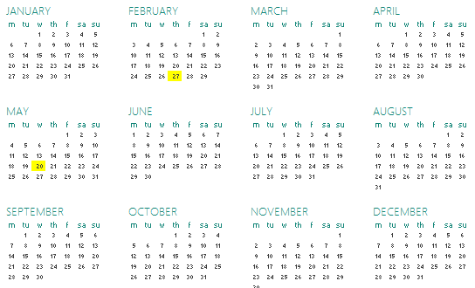
7. Meeting schedule
RCC
IG
SG
Next IG meeting: 15th Deceber? (tbd)

Slide 18
Thank you for attending

